Slide 1
Federal Borrowings Program
Borrowing for Credit Programs and Financing Account Interest
Brenda Woomer, CPA
Accountant, Borrowings Program Team
July 9, 2025

Slide 2
Presentation Overview
Overview of the Federal Borrowings Program
Federal Borrowings Program on TreasuryDirect.gov
Agency Guidance
Expenditure/Receipt Account Crosswalk
Federal Borrowings Program Reports
Federal Borrowings Fiscal Year-End Processing SUCCESS
Central Accounting Reporting System (CARS)
Credit Subsidy Calculator (CSC) Information
Intragovernmental Payment and Collection (IPAC) System
Fiscal Year-End Timeline

Slide 3
Federal Borrowings Roles and Responsibilities
Administer the Federal Borrowings Program for the Department of the Treasury
Review Authority
Review and Process
Principal transactions received in CARS
Account For and Report
Treasury’s loans receivable with related interest
Interest transactions received in IPAC System
Treasury’s interest payable associated with Interest on Uninvested Funds
Analyze and review legislative borrowing authority
Establish and renew loan agreements

Slide 4
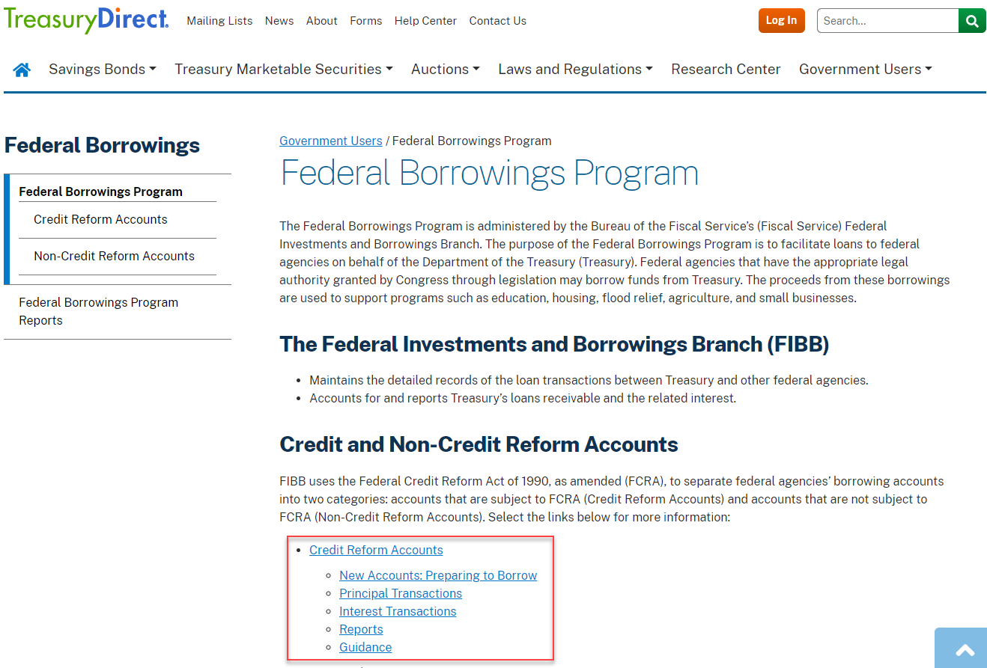
Federal Borrowings Program on TreasuryDirect
https://www.treasurydirect.gov/government/federal-borrowings-program/

Slide 5
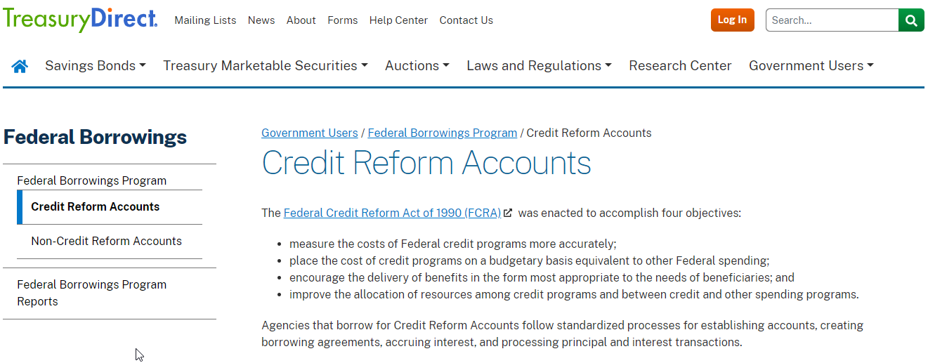
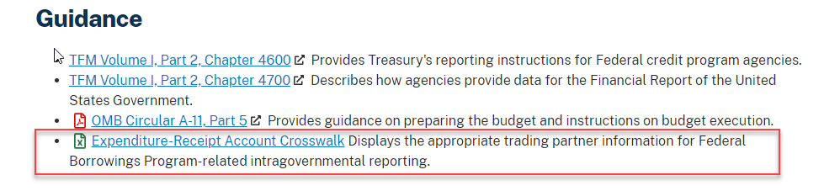
Agency Guidance on TreasuryDirect
https://www.treasurydirect.gov/government/federal-borrowings-program/credit-reform-accounts/
Intragovernmental Trading Partner Information

Slide 6
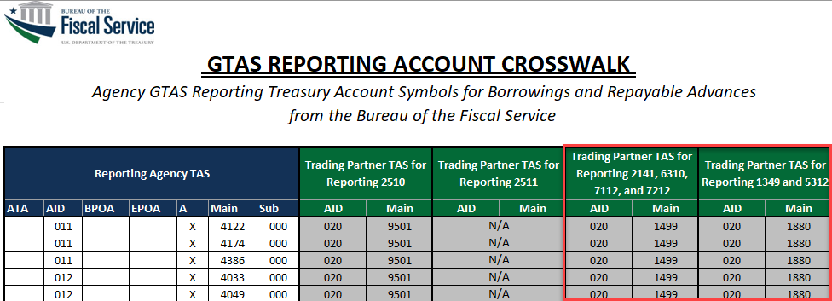
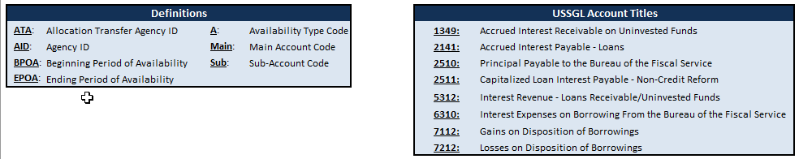
Expenditure/Receipt Account Crosswalk
Use to determine GTAS Trading Partner TAS information

Slide 7
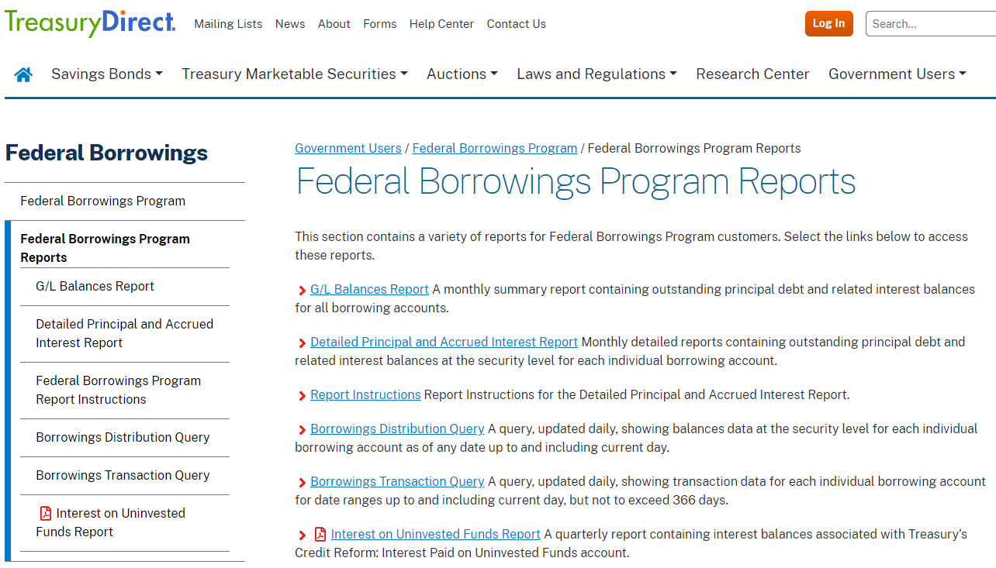
Federal Borrowings Program Reports
https://www.treasurydirect.gov/government/federal-borrowings-program/federal-borrowings-program-reports/

Slide 8
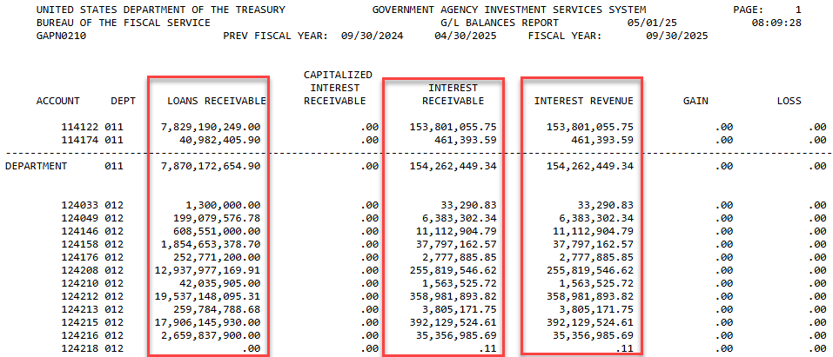
G/L Balances (Summary G/L Balances)
Provides the balances for Treasury’s Loans Receivable, Interest Receivable, and Interest Revenue for each TAS
Uploaded monthly

Slide 9
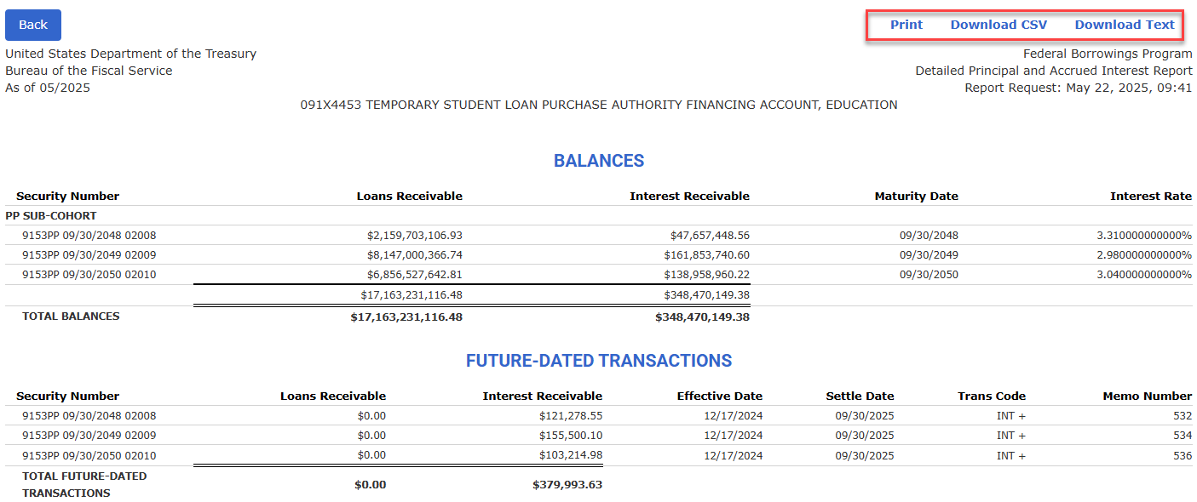
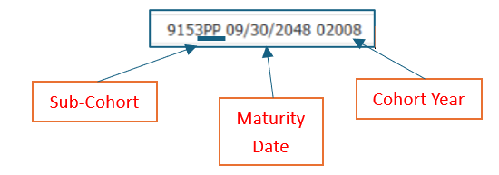
Detailed Principal and Accrued Interest

Slide 10
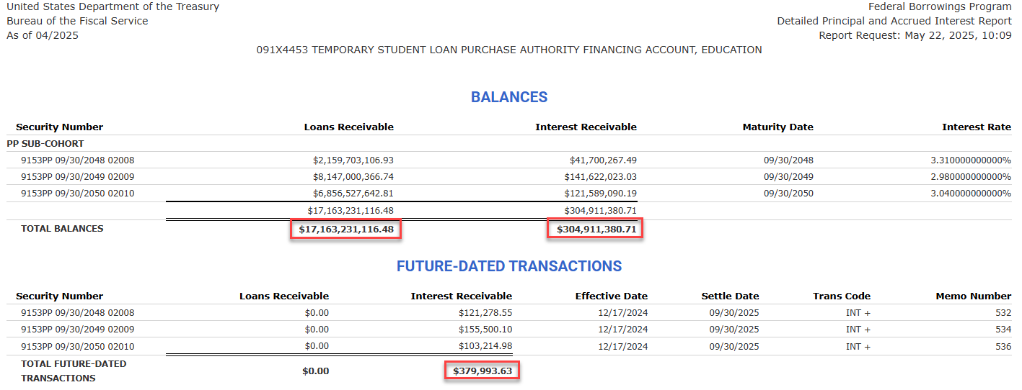
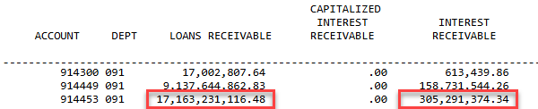
Comparing Borrowings Reports
Adding totals from Detailed Principal and Accrued Interest Report will equal the totals found on the G/L Balances Report
$ 304,911,380.71
$ 379,993.63
$ 305,291,374.34

Slide 11
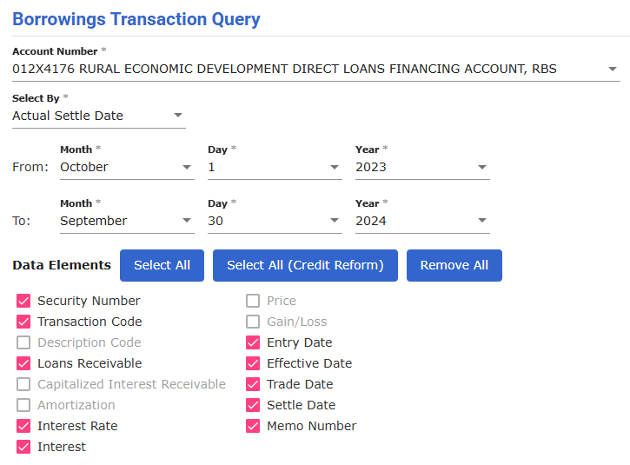
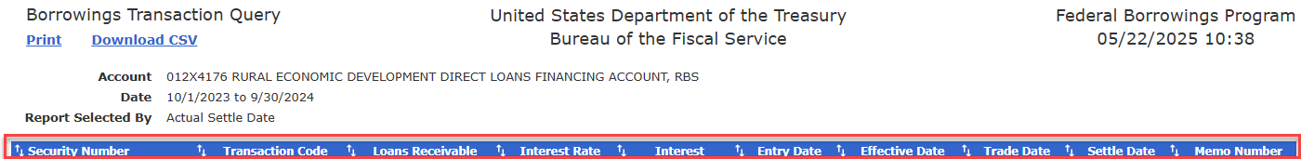
Borrowings Transaction Query

Slide 12
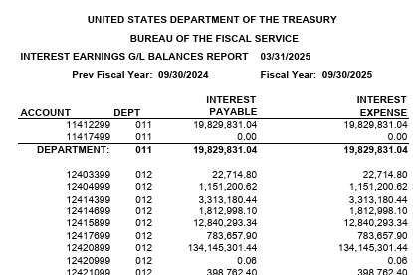
Interest on Uninvested Funds
Year-to-date accruals of Interest on Uninvested Funds
Uploaded quarterly

Slide 13

QUESTIONS?

Slide 14
Fiscal Year-End ‘SUCCESS’
Start of Year Balance verification
Update any inconsistencies if applicable
CARS: Borrowing / Repayment / Borrowing to Pay Interest
CSC completed and sent to Borrowings
E-mail verification received with submission details
Send IPAC for Interest Costs (if applicable)
Send IPAC for Interest Earned (if applicable)

Slide 15
Start of Year Balance Verification
(SUCCESS)
Treasury Direct Reports
Can be reviewed now
Summary General Ledger Report
Detailed Principal and Interest Report
Custom Reports
(SUCCESS)
Update Inconsistencies
Review Transactions
Borrowings
Repayments
Reclassifications – Sub-Cohort / Cohort / Maturity

Slide 16
CARS: Borrowing & Repayments
(SUCCESS)
Borrowings and Repayments in CARS
Maturing Loans
Indefinite Borrowing Authority
Enter transactions in CARS before submitting CSCs
Transactions may be entered early and future dated in CARS
CARS Transaction Status
Submit as soon as possible, but no later than 3:00pm ET on Tuesday, September 30th
Prepare for repayment of loans maturing 09/30/2025
Obligate or return any unobligated balance prior to the end of the fiscal year
Confirm all FY 2025 transactions have a status of ‘Posted’ before leaving the office on Tuesday, September 30th
Future Dated transaction will not post until the Effective Date

Slide 17
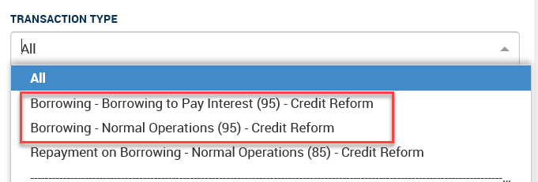
CARS vs CSC Transaction Classifications
The CSC differentiates principal borrowing transactions by CARS effective date, based on interest effects
CARS Borrowing Transaction Types
Transaction Type | Description | CARS Effective Date
Borrowing (start of year) | Borrowings initiated during the fiscal year due to normal operations | 10/01/2024
Interest Effect: Interest is accrued from 10/01 of the current fiscal year
Borrowing (end of year) | Borrowings initiated at fiscal year-end to pay interest | 09/30/2025
Interest Effect: Interest is not accrued in the current fiscal year

Slide 18
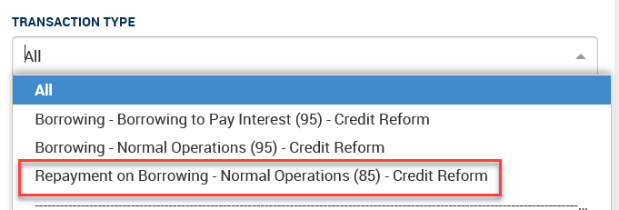
CARS vs CSC Transaction Classifications
The CSC differentiates principal repayment transactions by CARS effective date, based on interest effects
CARS Repayment Transaction Type
Transaction Type | Description | CARS Effective Date
Repayment (middle of year) | Repayments initiated from 10/01/2024 through 08/31/2025 | 10/01/2024 – 08/31/2025
Interest Effect: ½ year compounded interest is charged
Repayment (end of year) | Repayments initiated from 09/01/2025 through 09/30/2025 | 09/01/2025 – 09/30/2025
Interest Effect: Full year of interest is charged

Slide 19
CSC: Send Output to Borrowings
(SUCCESS)
Start of Year Balances
Proper Classifications
CSC Submission
Verify FY 2024 Debt to Treasury (end of year) is correct, including borrowings to pay interest made last year
Use TreasuryDirect website or email Borrowings@fiscal.treasury.gov to verify
Ensure all CARS transactions are reported and classified correctly in the CSC (SOY, MOY, EOY)
Submit final CSC output as soon as possible
Only one CSC should be submitted for each sub-cohort
All cohorts should be included in one CSC
To ensure prompt zipped file receipt, change .zip file name extensions (i.e. .zzp)

Slide 20
Submitting CSCs to Treasury
CSC Output File Name
Email CSC to Treasury
Subject line = CSC, the Treasury Account Symbol, and Revision # (if applicable)
Please include Treasury Account Symbol and Sub-Cohort (if applicable)
Example: 69X4123 635 Subcohort CSC.xlsx
Example: CSC – 69X4123 (Version 2)
Email all CSCs and related year-end correspondence to Borrowings@fiscal.treasury.gov
Submit all CSCs no later than 3:00pm ET on Tuesday, September 30th

Slide 21
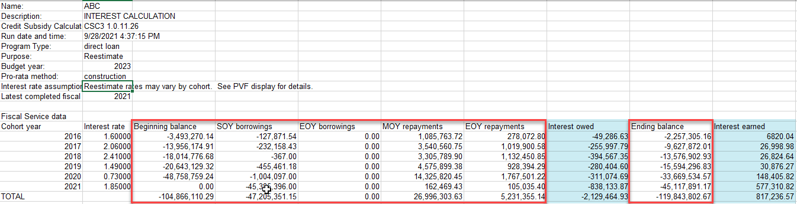
CSC Verification - Fiscal Service Tab
  Debt to Treasury (prior year-end)
  Borrowings from Treasury SOY
  Borrowings from Treasury EOY
  Repayments of Treasury Debt MOY
  Repayments of Treasury Debt EOY
  Debt to Treasury (current year-end)
  Interest Owed
  Interest Earned

Slide 22
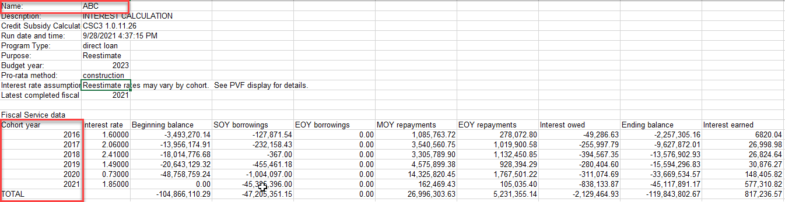
CSC Verification - Fiscal Service Tab
Only one CSC should be submitted for each sub-cohort
All Cohort Years must be included in one CSC

Slide 23
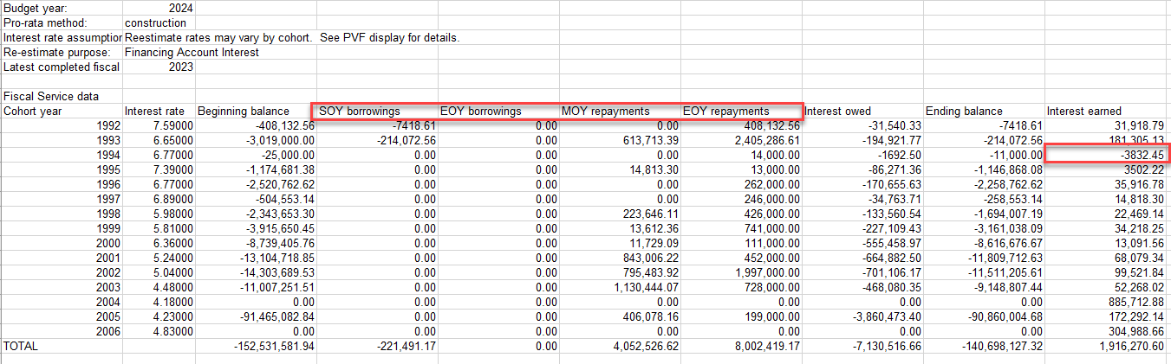
CSC Verification – Possible Issues
Misclassified or missing borrowings/repayments (SOY/EOY/MOY)
Negative Interest Earned amounts

Slide 24
Borrowings to Pay Interest
EOY Borrowings
Include all EOY Borrowings on the CSC
Additional Guidance
Supplemental spreadsheets for EOY Borrowings will not be accepted
EOY Borrowings do not affect the interest due for the current fiscal year
Treasury Financial Manual (TFM) Part 2 Chapter 4600 provides Credit Reform reporting instructions

Slide 25
E-mail Verification from Borrowings
(SUCCESS)
Notification sent from Borrowings
Specific Instructions Include:
After CSC has been verified
Before agency enters any IPAC(s)
Amount – Interest Cost and Interest Earned
ALC – Interest Cost and Interest Earned
BETC – Interest Cost vs Interest Earned

Slide 26
Send IPAC for Interest Costs
(SUCCESS)
IPAC System entry for interest cost
Agency Locator Code (ALC) = 20550865
Sender TAS varies by account
Receiver TAS = 020 1499 000
Sender / Receiver Business Event Type Code (BETC) varies by transaction type (see below)
Transaction Type | Entity | TAS | BETC*
Payment | Sender | Agency Expenditure Account | BFSXPD
 | Receiver | 020 1499 000 | TREACEXP
Use when submitting an interest payment.
Adjustment | Sender | Agency Expenditure Account | BFSXAJ
 | Receiver | 020 1499 000 | TREACAJ
Use when submitting a correction of an overpayment of interest. Please Contact Borrowings before entering an adjustment.

Slide 27
Send IPAC for Interest Earned
(SUCCESS)
IPAC System entry for interest earned
Agency Locator Code (ALC) = 20120002
Sender TAS varies by account
Receiver TAS = 020 X 1880 000
Sender / Receiver Business Event Type Code (BETC) varies by transaction type (see below)
Transaction Type | Entity | TAS | BETC*
Collection | Sender | Agency Expenditure Account | BFSINTC
 | Receiver | 020 X 1880 000 | TREADIN
Use when submitting an interest collection.
Adjustment | Sender | Agency Expenditure Account | BFSINAJ
 | Receiver | 020 X 1880 000 | TREADAJ
Use when submitting a correction of a collection of interest. Please Contact Borrowings before entering an adjustment.

Slide 28
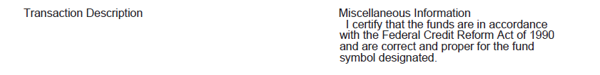
Certification Statement Requirement
Section 4645 of TFM Volume 1, Part 2: When submitting an IPAC for Interest Earnings agencies must:
“certify that the interest amount was computed per applicable guidance by including a certification statement on the IPAC System transaction that states, ‘I certify that the funds are in accordance with the Federal Credit Reform Act of 1990 and are correct and proper for the fund symbol designated.’”
Include certification in the Miscellaneous Information or Transaction Description of the IPAC Document.
Notes:
Most agencies place this statement within the ‘Transaction Description’ section of the IPAC document

Slide 29
Credit Reform Interest Transactions
Department Name | Interest Costs (Payment) | Interest Earnings (Collection)
Sender TAS | 069 X 4123 000 | 069 X 4123 000
Sender BETC* | BFSXPD | BFSINTC
Receiver TAS | 020 1499 000 | 020 X 1880 000
Receiver BETC* | TREACEXP | TREADIN
Receiver ALC | 20550865 | 20120002
Description | FY25 Interest Cost | Certification Statement
Interest Transaction Reminders
DO NOT net Interest Costs and Interest Earnings
Certification Statement on Interest Earnings IPAC
IPAC System: Hard Cutoff at 11:59pm ET on 09/30

Slide 30
Submitting IPAC Transactions
Submit interest transactions via the IPAC system after receiving confirmation that Treasury has verified the CSC
Verify the amounts transacted on the IPAC equal the Interest Amounts confirmed in the CSCs
The agency representative that submitted the CSC will be notified via email after verification has been completed
Interest transactions can be entered any time after CSC verification email is received
Submit one transaction per TAS for each interest transaction for all cohorts and sub-cohorts – one payment and one collection
Do not net interest owed with interest earned
Submit interest transactions in the IPAC system no later than 3:00 pm ET on Tuesday, September 30th

Slide 31
Fiscal Year-End “SUCCESS” Timeline
S
Start of Year Balance Verification
When? Today
U
Update any inconsistencies
When? Today
C
CARS Borrow / Repay / Borrow to Pay Interest
When? 08/31/2025 Cutoff for Middle of Year Repays / Half Year Interest
C
CSC Completed and output sent to Borrowings
When? As soon as possible after CARS transactions complete
E
E-mail verification received from Borrowings
When? After CSC verified / Before IPAC payments
S
Send IPAC for Interest Costs
When? As soon as possible AFTER email verification received from Borrowings
S
Send IPAC for Interest Earned
When? As soon as possible AFTER email verification received from Borrowings

Slide 32

QUESTIONS?
CONTACT INFORMATION:
Federal Borrowings Program
Borrowings@fiscal.treasury.gov

